Slide 1
Computer Graphics
By- Manoj R Mishra

Slide 2
Literature
Computer Graphics - Principles and Practice
Foley - van Dam - Feiner - Hughes
2nd edition in C - Addison and Wesley
Computer Graphics - C Version
Donald Hearn - M. Pauline Baker
2nd edition - international edition
Prentice Hall

Slide 3
Introduction
What is Computer Graphics?
Applications
Raster/vector graphics
Hardware

Slide 4
Supporting Disciplines
Computer science (algorithms, data structures, software engineering, …)
Mathematics (geometry, numerical, …)
Physics (Optics, Mechanics, …)
Psychology (Colour, Perception)
Art and design

Slide 5
Applications
Computer Aided Design (CAD)
Computer Aided Geometric Design (CAGD)
Entertainment (animation, games, …)
Geographic Information Systems (GIS)
Visualization (Scientific Vis., Inform. Vis.)
Medical Visualization
…

Slide 6
Interactive Computer Graphics
e.g., games
User
input
Application
Screen
image

Slide 7
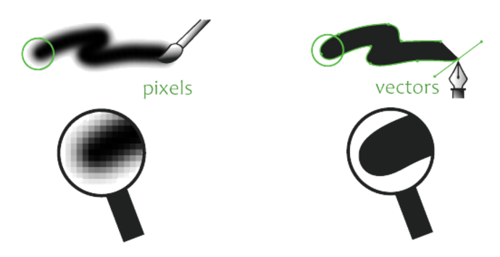
Representations in graphics
1) Vector
2) Bitmap.

Slide 8
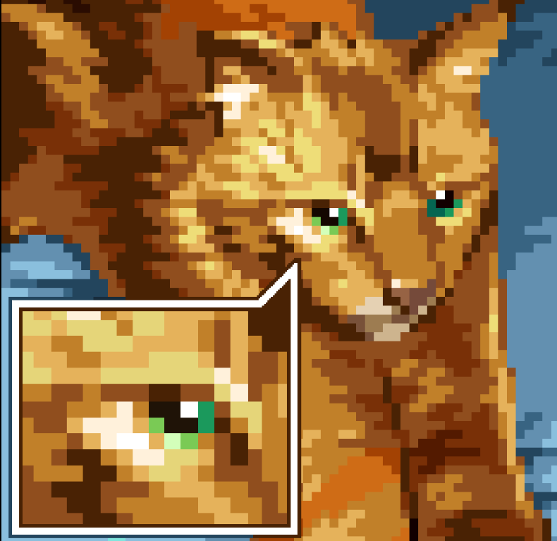
IMAGE : how to store?
image consists of pixels.
  i.e. picture elements
  i.e. a smallest representable element on the screen.
  Each pixel requires several bits to store its color, intensity etc.

Slide 9
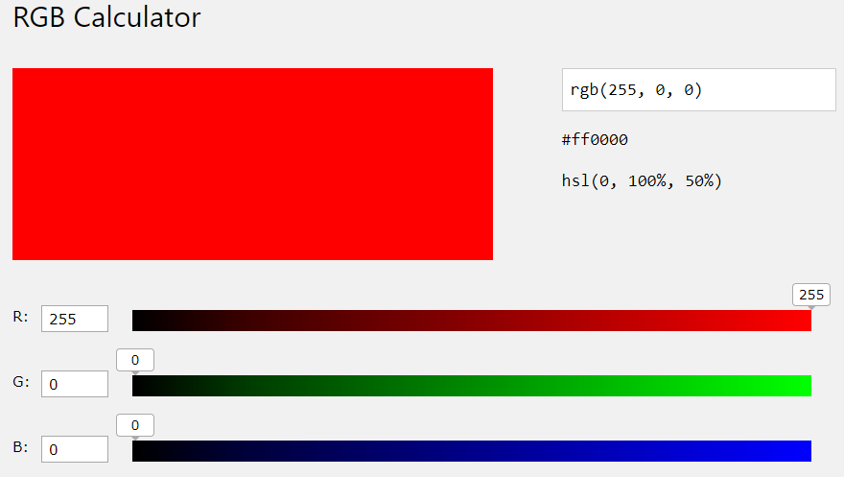
RGB Colour
8 bits can represent 2⁸ = 256 colors
24 bits (R+G+B) can represent
  2²⁴ = 16.8 million colors
  true photographic colors

Slide 10
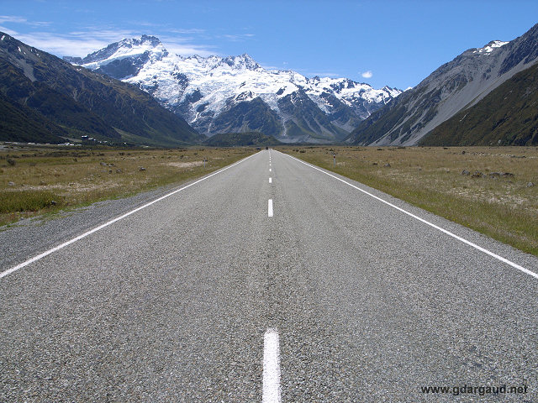
Size requirement in memory
    Ex- digital camera
      48 bit in latest camera
      Megapixel Camera
      memory needed to load the full image= WIDTH x HEIGHT x (BITS PER PIXEL)
      An Image of 640 x 480 pixels
      640 x 480 x 24 = 7,372,800 bits.
      7,372,800 bits/ 8 = 921,600 Bytes
      921,600/1024 = 900 KB
      Compression - save as JPEG

Slide 11
Image file formats
Uncompressed format and Compressed format
Raster formats:
JPEG/JFIF - (Joint Photographic Experts Group) is a lossy compression method; JPEG-compressed images are usually stored in the JFIF (JPEG File Interchange Format) file format. The JPEG/JFIF filename extension is JPG or JPEG. Nearly every digital camera can save images in the JPEG/JFIF format,
Exif- (Exchangeable image file format) format is a file standard similar to the JFIF format with TIFF extensions
TIFF - (Tagged Image File Format) format is a flexible format usually using either the TIFF or TIF filename extension.
GIF - (Graphics Interchange Format) is in normal use limited to an 8-bit palette, only 256 colors
BMP - BMP file format (Windows bitmap) Typically, BMP files are uncompressed, and therefore large and lossless; their advantage is their simple structure and wide acceptance in Windows programs.

Slide 12
Contd…
PNG- (Portable Network Graphics) file format was created as a free, open-source alternative to GIF. The PNG file format supports eight-bit paletted images and 24-bit truecolor (16 million colors) or 48-bit truecolor with and without alpha channel – while GIF supports only 256 colors and a single transparent color.
PPM, PGM, PBM, and PNM
Netpbm format is a family including the portable pixmap file format (PPM), the portable graymap file format (PGM) and the portable bitmap file format (PBM). Converting pixmap, graymap, or bitmap files between different platforms. Several applications refer to them collectively as PNM ("Portable aNy Map").

Slide 13
Contd…
WebP
WebP is an open image format. designed by Google to reduce image file size to speed up web page loading: its principal purpose is to supersede JPEG as the primary format for photographs on the web.
HDR - High-dynamic-range imaging (HDRI) is a technique used in photographic imaging and films, and in ray-traced computer-generated imaging, to reproduce a greater range of luminosity than what is possible with standard digital imaging or photographic techniques.

Slide 14
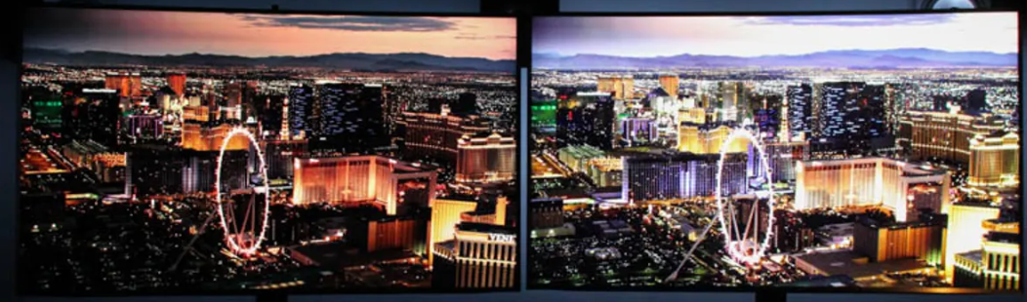
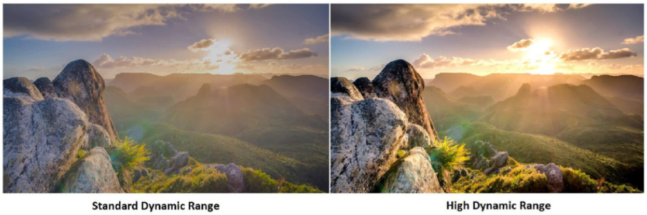
non-HDR vs. HDR
HDR can deliver brighter and sharper highlights

Slide 15
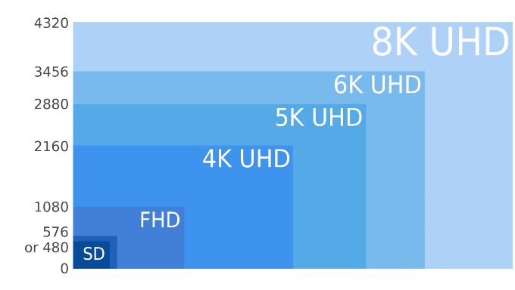
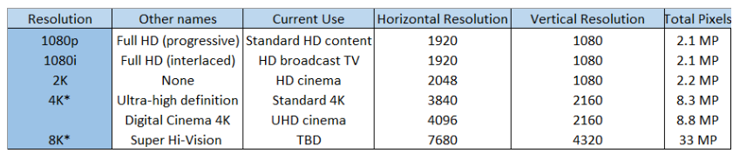
Video Representation

Slide 16
Representations in graphics
Vector Graphics
Image is represented by continuous geometric objects: lines, curves, etc.
Raster Graphics
Image is represented as a rectangular grid of coloured squares

Slide 17
Vector graphics
Graphics objects: geometry + colour
Complexity ~ O(number of objects)
Geometric transformation possible without loss of information (zoom, rotate, …)
Diagrams, schemes, ...
they are size independent, meaning that they could be resized with no loss in quality
Examples: PowerPoint, CorelDraw, ...

Slide 18
Raster graphics
bitmapped graphics are digital images composed of pixels
Geometric Transformation: loss of information
Complexity ~ O(number of pixels)
Jagged edges, anti-aliasing
Realistic images, textures, ...
provide a richer depth of colour but are size dependent
Examples: Paint, PhotoShop, ...
file formats such as GIF, JPG, and BMP,

Slide 19
Raster (Bitmap)
• Pixel-based
• Raster programs best for editing photos and creating continuous tone images with soft color blends
• Do not scale up optimally - Image must be created/scanned at the desired usage size or larger
• Large dimensions & detailed images equal large file size
• It is more difficult to print raster images using a limited amount of spot colors
• Some processes cannot use raster formats
• Depending on the complexity of the image, conversion to vector may be time consuming
• Raster images are the most common image format, including: jpg, gif, png, tif, bmp, psd, eps and pdfs originating from raster programs
• Common raster programs: photo editing / paint programs such as Photoshop & Paint Shop, GIMP (free)
Vector
• Shapes based on mathematical calculations
• Vector programs best for creating logos, drawings and illustrations, technical drawings. For images that will be applied to physical products.
• Can be scaled to any size without losing quality
• Resolution-independent: Can be printed at any size/resolution
• A large dimension vector graphic maintains a small file size
• Number of colors can be easily increased or reduced to adjust printing budget
• Vector art can be used for many processes and easily rasterized to be used for all processes
• Can be easily converted to raster
• It is not the best format for continuous tone images with blends of color or to edit photographs
• Common vector graphic file format: ai, cdr, svg, and eps & pdfs originating from vector programs

Slide 20
Conversion
Vector graphics
Rasterization, Pattern recognition
Scan conversion
Raster graphics

Slide 21
Vector Graphics Hardware
Display list
continuous & smooth lines
no filled objects
random scan
refresh speed depends on complexity of the scene
move 10 20
line 20 40
...
char O
V E C T O R
char R
Display Controller

Slide 22
Raster Graphics Hardware
Frame buffer
0
0
0
0
0
0
0
7
7
7
6
Video Controller
0
7
7
7
R A S T E R
0
0
0
0
0
0
jaggies (stair casing)
filled objects
(anti)aliasing
refresh speed independent of scene complexity
pixel
scan conversion
resolution
bit planes

Slide 23
Applications
Photo Editing: There are three big players in image manipulation:
1) PhotoShop (Adobe)
2) FireWorks (Macro Media)
3) Corel (owned by Corel)
Video editing
IMovie (apple. Not the best, but easy to use.)
Adobe Premiere (Adobe)
Final Cut Pro (Apple)
Studio Version 9 (Pinnacle Systems)
Web Design and Editing To make and edit a website, the big three softwares are:
1)DreamWeaver (MacroMedia)
2) Frontpage (MicroSoft)
3) Go Live (Adobe)
4)Netscape Composer (Netscape).

Slide 24
Scientific Modelling & Visualisation
visualization tools for solving problems in biology, aeronautics, medical imaging, and other disciplines
Image Processing
Graphics Image Processing: commonly used software is: Photoshop.
Geographic Information Systems (GIS): The most commonly used software is: ArcMap.
Remote Sensing Packages: Commonly used software is: ERDAS
Numerical Analysis Packages: Commonly used software is: MatLab.
CAD (or CADD) stands for Computer-Aided Design and Drafting. It differs from both “paint” and “draw”

Slide 25
Simulation : simulation model to replicate the actual system.
VR
Animation and Games

Slide 26
GRAPHICS HARDWARE
Input and Output Devices
• Touch Panel
• Light Pens
• Graphics Tablet
• Plotters

Slide 27
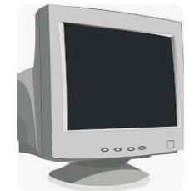
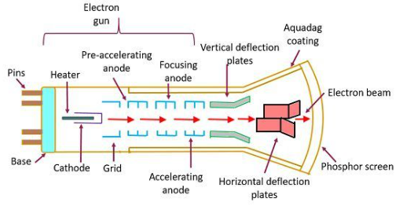
Display Devices
Cathode Ray Tube: It is a refreshing display device.

Slide 28
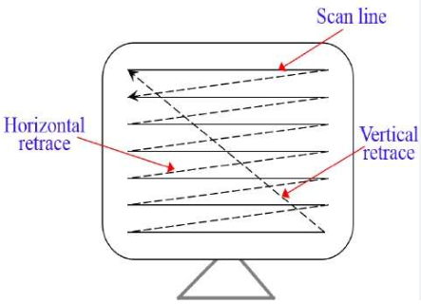
Raster Scan.
Frame Buffers
stores the picture information, which is the bit plane (with m rows and n columns).
refresh storage area in the digital memory
Refresh Rate
how many times per second the display is able to draw a new image.
60Hz, 120Hz, 144Hz, 240Hz, 360Hz …

